Slide 1

Exploring Access to Health Care in the U.S. on an interactive dashboard.
Ghita Moummi
DATA606_Capstone
FALL2020

Slide 2

Agenda
Why is this important?
Similar Project
How is this project different?
Planning and implementing the project
The dataset
Next steps

Slide 3
Why is this important?
There is a large inequity in health care distribution across the US. These iniquities result in an inequity in illness distribution (Meyer et. Al., 2013)
Adequate access to healthcare translates to less illness
Inadequate access to healthcare translates to more illness
Visualizing access to healthcare and distribution of disease in the U.S. can help us know where we should invest more money and on which conditions.
Notes:
Using preventive health services can substantially reduce morbidity and mortality in the U.S.. Therefore, continuous monitoring of preventive services use and chronic diseases is essential to the development of health promotion strategies, intervention programs, and health policies at the state, city, and county level (Chowdhury et. Al., 2012).

Slide 4
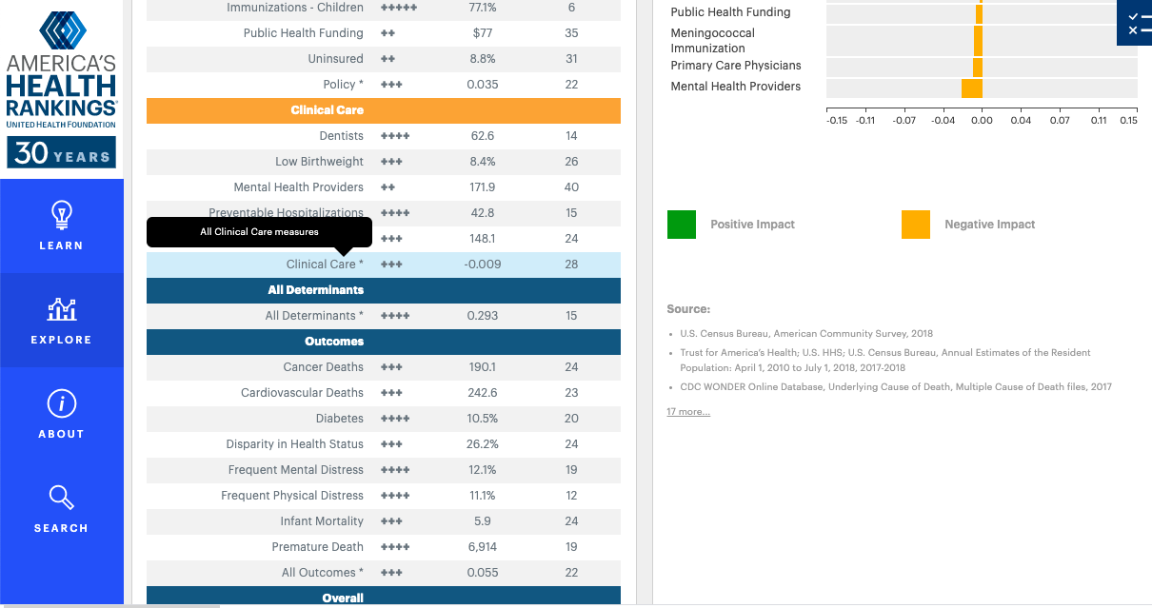
Similar Projects
America’s health rankings dashboard:
shows how the United States is doing as a whole in different aspects (behavior, healthcare access, outcomes, chronic diseases, education…etc.)
shows how each state is doing for the same aspects and its ranking compared to the other states.
The picture on the left shows an example for Virginia.
Source: https://www.americashealthrankings.org/explore/annual/measure/PCP/state/ALL

Slide 5

How is this project different?
My dashboard will focus on access to healthcare and diseases only.
In addition to how states are doing compared to each other, I will also add how counties in each state are doing. As a result, we will have outcomes that show us where to invest no only on the federal level, but also on a state level.
My dashboard will also have ranking of diseases (most urgent to least urgent) in order to know which disease to tackle first in each state, as well as each county.

Slide 6
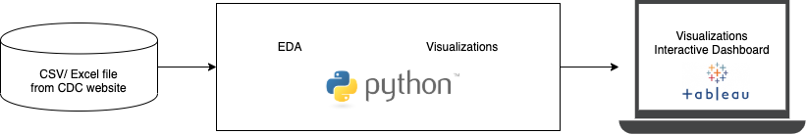
Planning and implementing the project (Data Flow& Architecture Diagram)

Slide 7

The dataset
CHSI dataset source:
https://ftp.cdc.gov/pub/Health_Statistics/NCHS/Datasets/CHDI/chsi_dataset.zip
It is a zip file containing many datasets. Datasets used:
Demographics: 44 columns; 3141 rows
Risk factors and access to healthcare: 31 columns; 3141 rows
Preventive service use: 43 columns; 3141 rows
Measures of birth and death: 141 columns; 3141 rows
After merging the datasets, and selecting the needed columns, we have: 34 columns, and 3141 rows

Slide 8
Next steps.. Exploratory Data Analysis(EDA)
The EDA will explore the following:
The correlation between preventive health services and disease
No care during 1st trimester of pregnancy vs. pregnancy complications (premature birth, low birth weight, and infant mortality)
Mammography vs. breast cancer
Sigmoidoscopy vs. colon cancer in adults 65+ years old
Pneumonia vs. lung cancer
The correlation between number of primary care practioners (PCPs) and chronic/other diseases
The correlation between chronic diseases (obesity, diabetes, and high blood pressure) and number of deaths /life expectancy
Other…

Slide 9
References
Chowdhury, P. P., Mawokomatanda, T., Fang Xu, Gamble, S., Flegel, D., Pierannunzi, C., Garvin, W., & Town, M. (2016). Surveillance for Certain Health Behaviors, Chronic Diseases, and Conditions, Access to Health Care, and Use of Preventive Health Services Among States and Selected Local Areas -- Behavioral Risk Factor Surveillance System, United States, 2012. MMWR Surveillance Summaries, 65(4), 1–139. https://doi-org.proxy-bc.researchport.umd.edu/10.15585/mmwr.ss6504a1
Gamble, S., Mawokomatanda, T., Fang Xu, Chowdhury, P. P., Pierannunzi, C., Flegel, D., Garvin, W., & Town, M. (2017). Surveillance for Certain Health Behaviors and Conditions Among States and Selected Local Areas -- Behavioral Risk Factor Surveillance System, United States, 2013 and 2014. MMWR Surveillance Summaries, 66(16), 1–139. https://doi-org.proxy-bc.researchport.umd.edu/10.15585/mmwr.ss6616a1
Meyer, S. B., Luong, T. C., Mamerow, L., & Ward, P. R. (2013). Inequities in access to healthcare: analysis of national survey data across six Asia-Pacific countries. BMC Health Services Research, 13(1), 238–250. https://doi-org.proxy-bc.researchport.umd.edu/10.1186/1472-6963-13-238
https://unsplash.com/s/photos/

Slide 10
Thank you!
Questions?
gmoummi1@umbc.edu
https://github.com/gmoummi/Capstone_Project/tree/master

